Slide 1

LOW-CARB Capacity Building Workshop –
Regional Sustainable Urban Mobility Planning for Functional Urban Areas
25 May 2018, Brno, Czech Republic. 1445-1500
Linking up with EUROPEANMOBILITYWEEK
Jerome Simpson/Regional Environmental Center for CEE/Hungary & EMW Secretariat

Slide 2


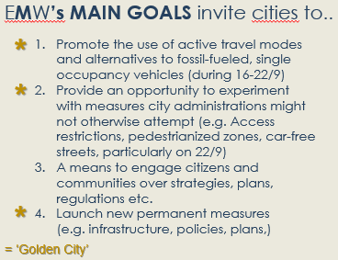
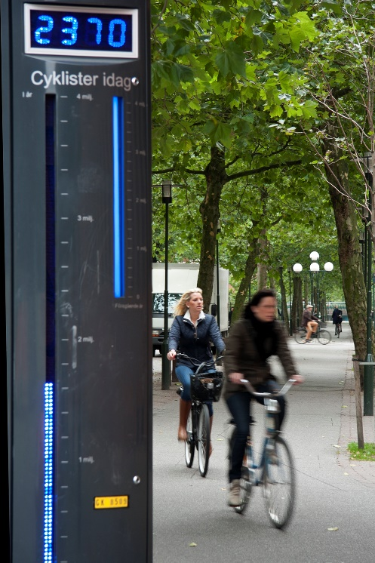
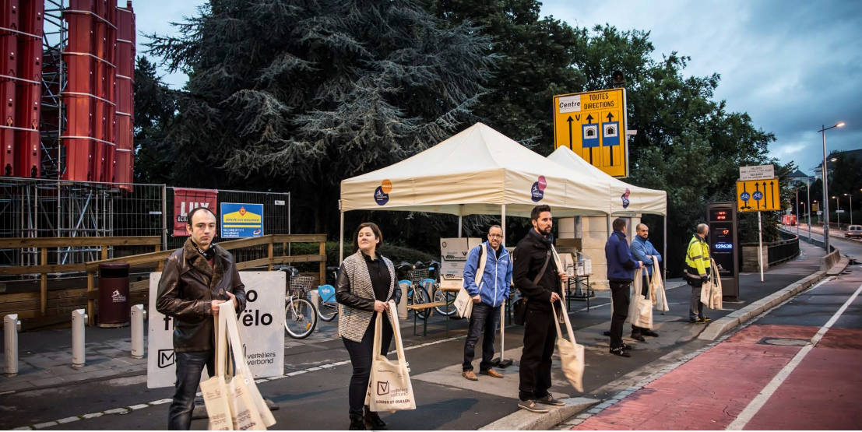
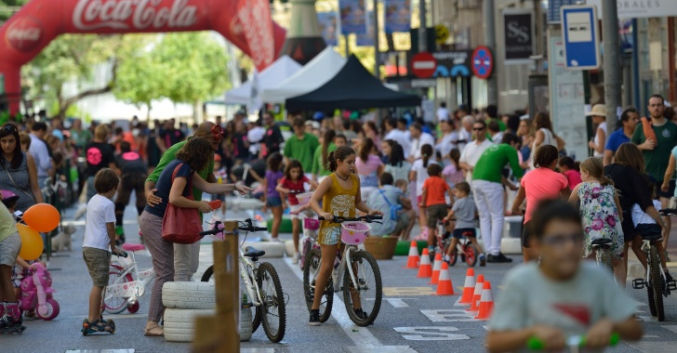
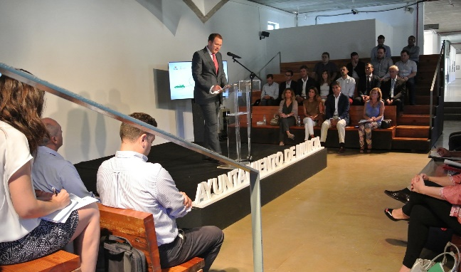
Campaign Background
4
1
2
3

Slide 3

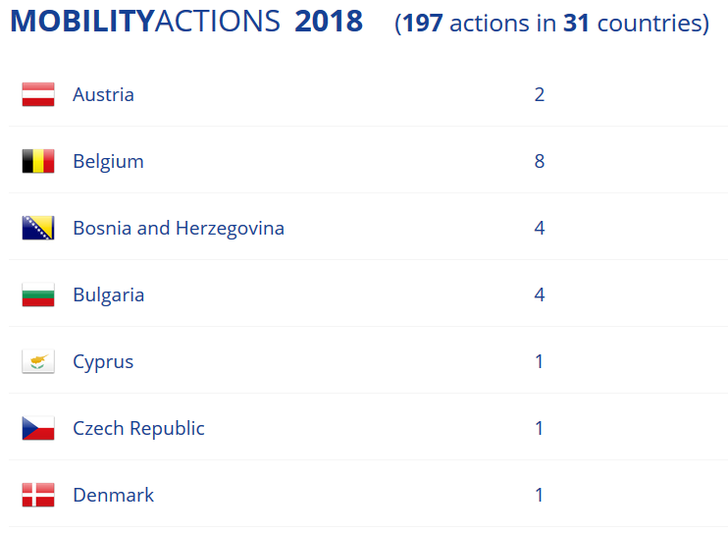
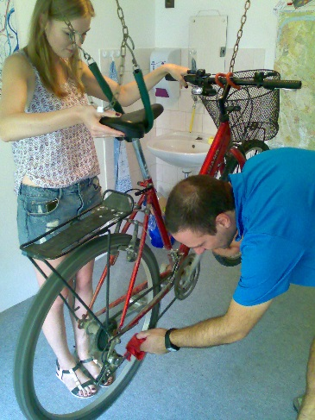
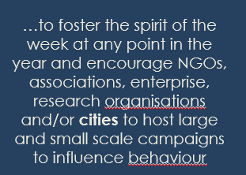
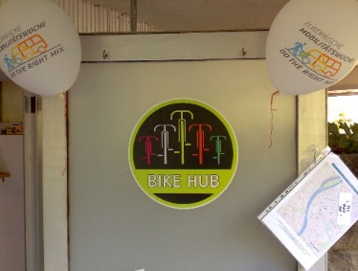
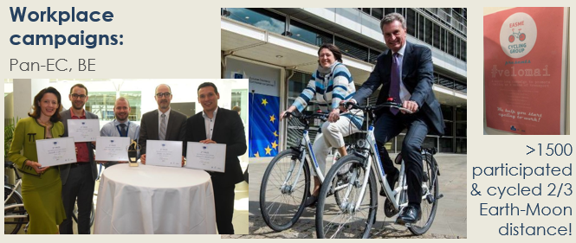
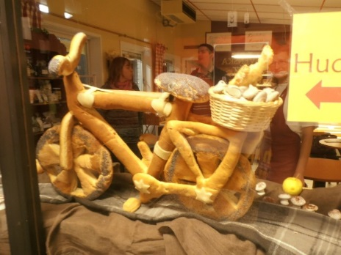
’Dr. Bike’

Slide 4

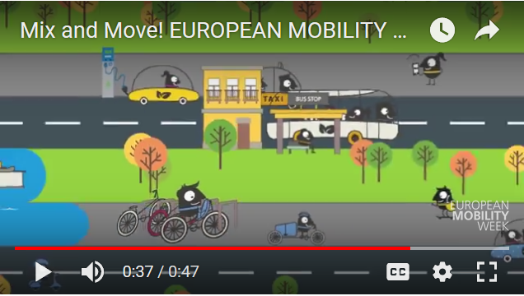
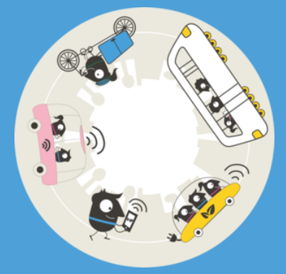

Multi-modality =
different modes of transport for the same journey

Slide 5
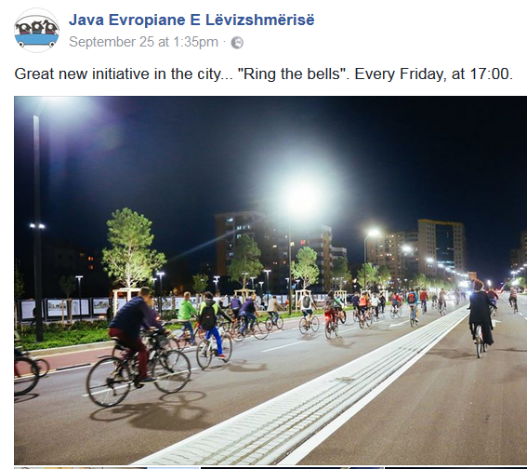
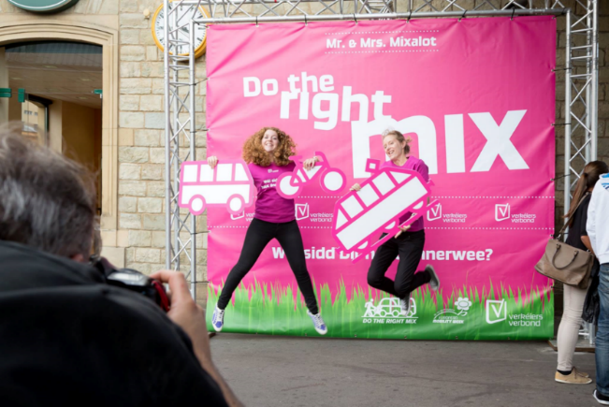
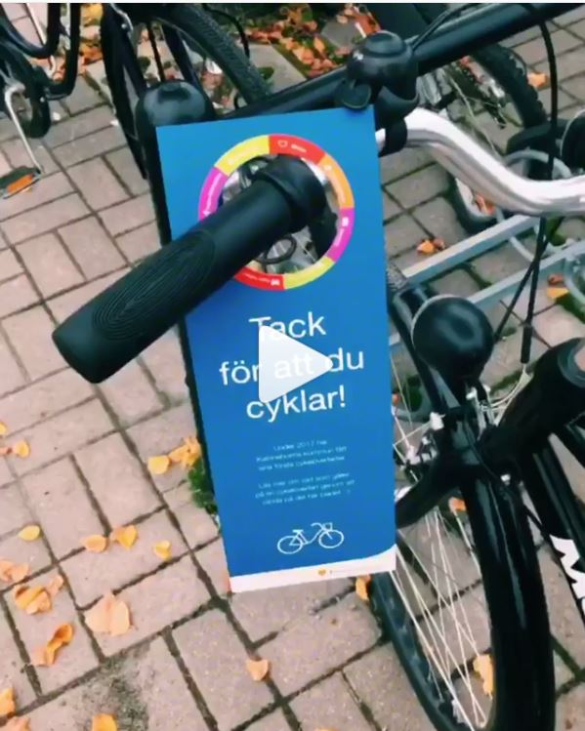

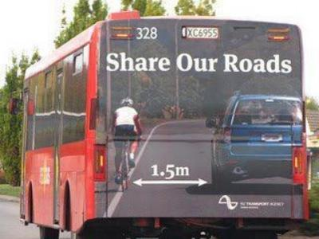
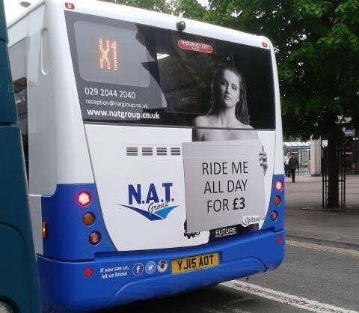
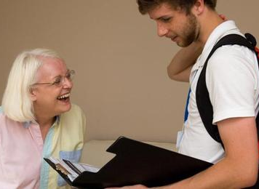
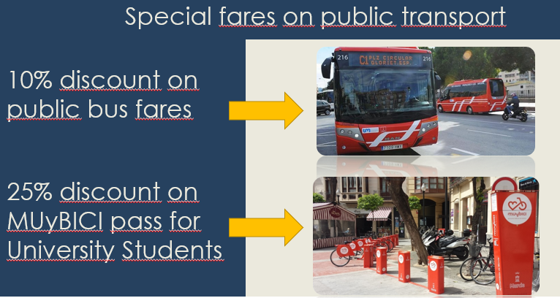
1. ADVOCATING (LOW-CARB) ACTIVE TRAVEL/Car-free alternatives..
Deluxe activities are for example: Extra traffic and mobility education in the class rooms; Mapping the safe routes to school; Cycle training on the school playground or in the school environment; A bike bell concert; Shoe polish and bike wash; Exhibition of children’s drawings on the theme…
INTEGRATED
Notes:
Middle Top: Communication campaigns incl. participative events in which a hostess and a photographer took pictures of public transport users holding cardboard cut-outs representing the combination of modes of transport they used on a daily basis. The picture of them with their mobility chain in their hands was posted on FB and they waited for their friends to ‘like’ it. The top 5 most liked winners won the same prize: a bag of goodies (Gadgets, T-Shirt etc.) and a Trollmops (sustainable mobility) Boardgame.
Top Right: A great way to raise awareness among schoolchildren of different modes is The Traffic Snake Game, which runs over 10 days and surveys classes’ travel to school and maps it on a single banner (a snake). It was first piloted in the UK in 2008 in London schools and proved a huge success with schools seeing an increase in sustainable journeys and a reduction in carbon emissions over the three years it was played. Besides giving out rewards for achievement, the totals show mobility achievements and changes. Deluxe activities are for example: Extra traffic and mobility education in the class rooms; Mapping the safe routes to school; Cycle training on the school playground or in the school environment; A bike bell concert; Shoe polish and bike wash; Exhibition of children’s drawings on the theme…

Slide 6
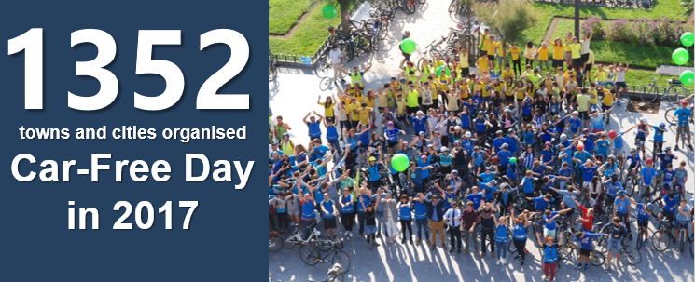
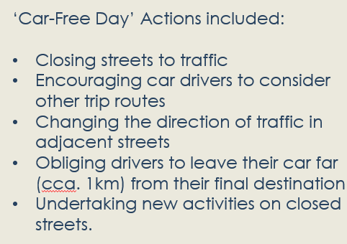
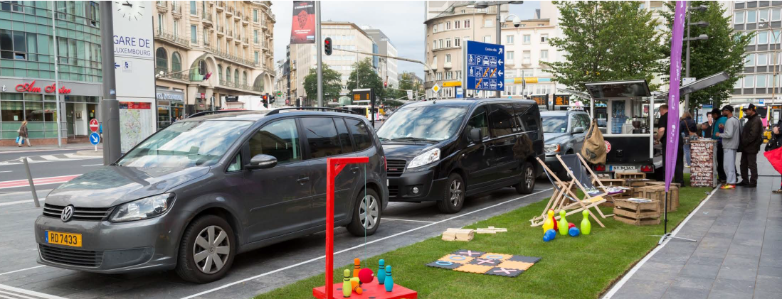
2. (LOW-CARB) CAR-FREE DAY..

Slide 7
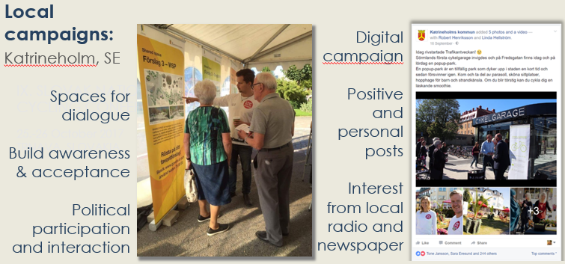
3. CITIZEN ENGAGEMENT...(URBAN PLANs)
Notes:
Making an urban development plan happen. Little Katrineholm abandoned car-free day before deciding it needed to be 100% involved. This was because it brought value to Katrineholm vis-a-vis sustainable urban mobility planning and the need to get citizens’ opinions on board + raise awareness of mobility matters. Why a mobility plan? The space within our city has become more valuable as we grow in number of inhabitants as well as enterprises, which further the need for efficient mobility that demands less space. The need for a future infrastructure that decreases known problems of pollution and tackles safety issues is also a key aspect in why the plan is needed. The key aspect to fulfilling the development program and the plan is, as in many cities, to create many equally efficient means of transport for inhabitants. (in short less space for cars and more space for walking/cycling and public transport= controversial for a rural city that has been car dependent for the last 50 years or so.) Many of these actions are being put into reality right now, which means a lot of remodelling of streets are happening, as well as tightening the availability for parking. This of course affects inhabitants and sparks some distress and discomfort. Here EMW has been a great tool to use for our positive communication and as a means for behavioural change.

Slide 8
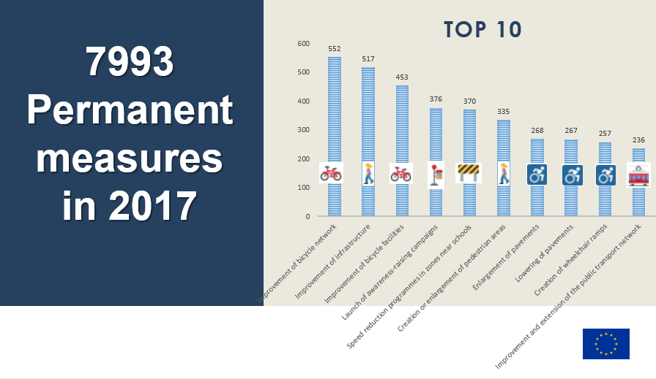
4. PERMANENT MEASURES (PILOT MEASURES)
Notes:
1295 cities implemented those perm. measures, down from last year (1229). That’s 42% of the total # cities.
1 and 3 = ‘New or improved bicycle facilities’
2 and 6 = Pedestrianisation
4 = Mobility management
5 = Traffic calming and access control scheme
7, 8, 9 = Acccessibility
10 = Public transport services
Permanent measure = Installed infrastructure or equipment, launched new services or regulations, and/or adopted mobility plans

Slide 9
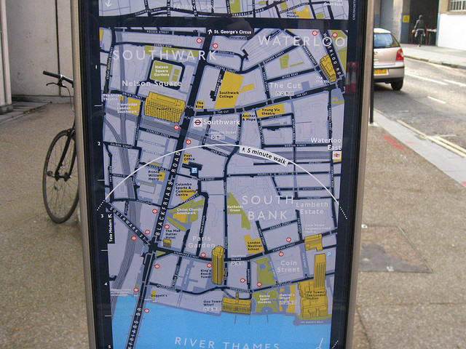
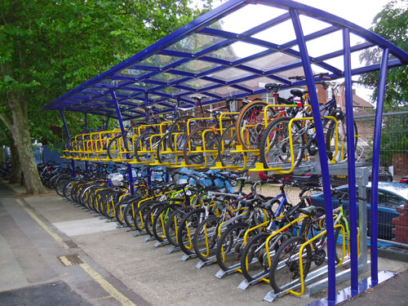
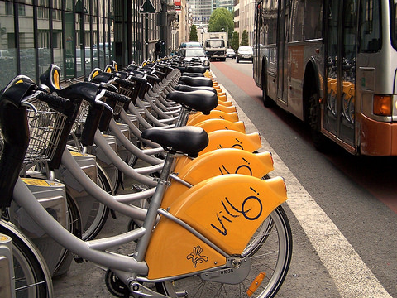
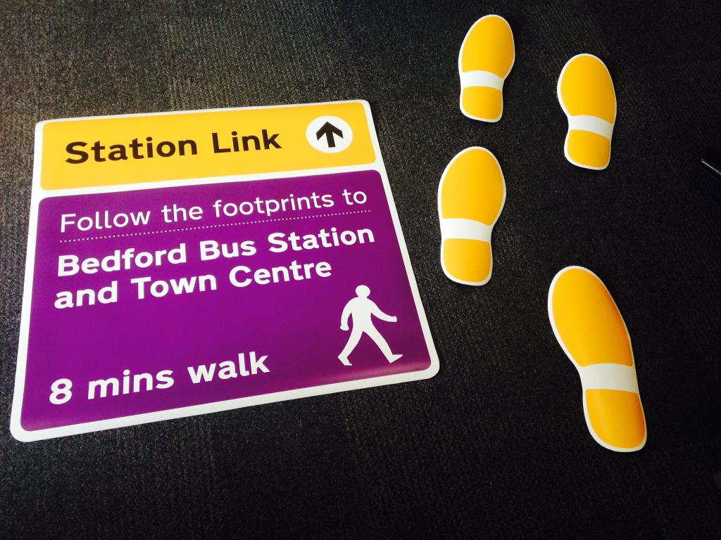
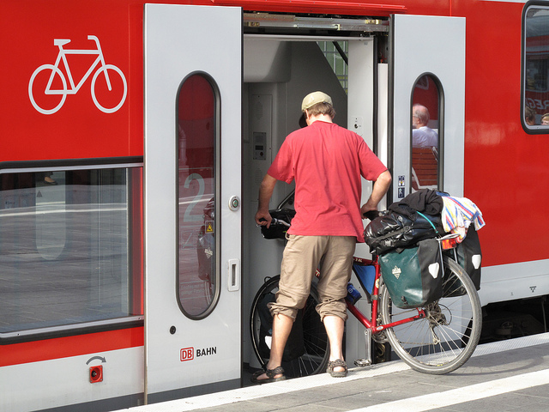
„Public Transport is by default multi-modal!“
BIKE & (BUS) RIDE
WALK & (BUS) RIDE
BIKE & (TRAIN) RIDE
PERM. MEASURE EXAMPLES (PT)

Slide 10

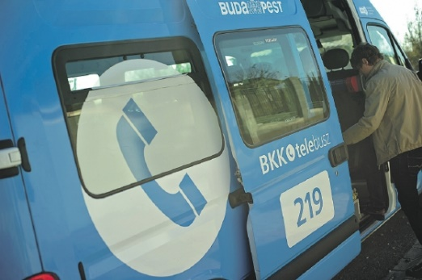

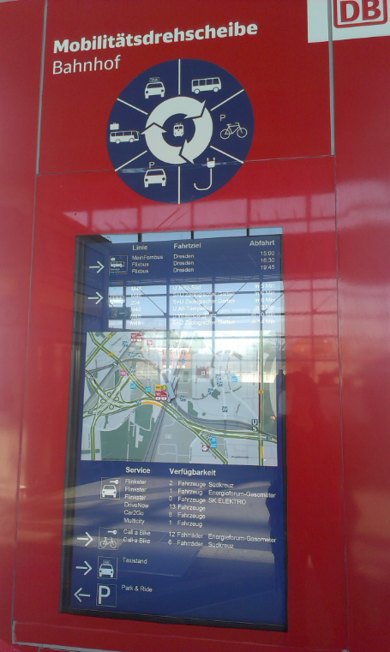
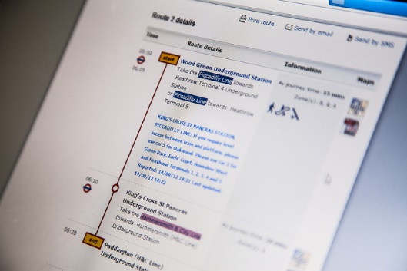
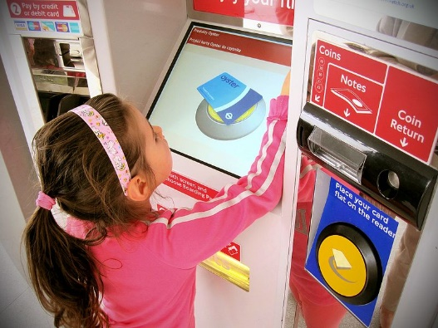
PERMANENT MEASURE EXAMPLES (PT)
(CAR/BUS
& RIDE)
TOOLS & SERVICES
Notes:
Middle: Multimodal journey planners
Bottom Middle: Multimodal integrated ticketing
Bottom Left: Multi-modal info point

Slide 11
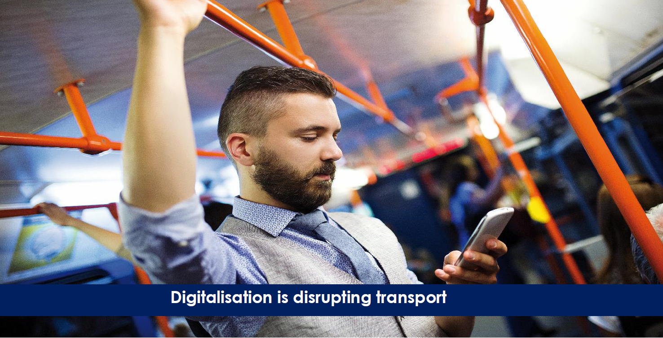

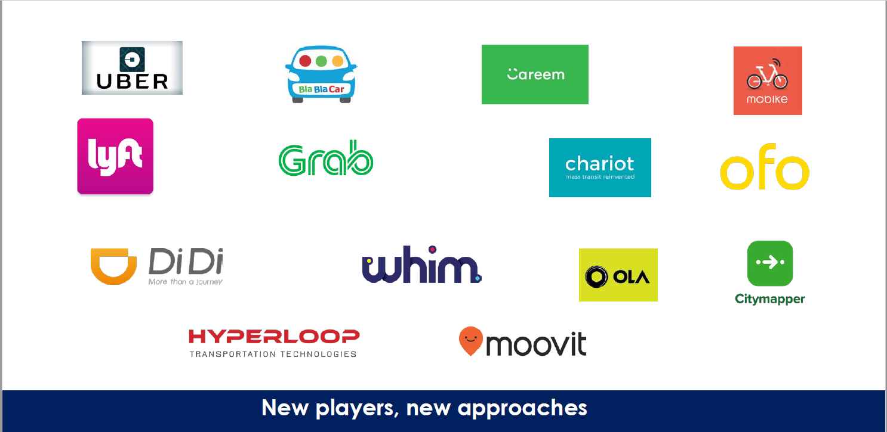
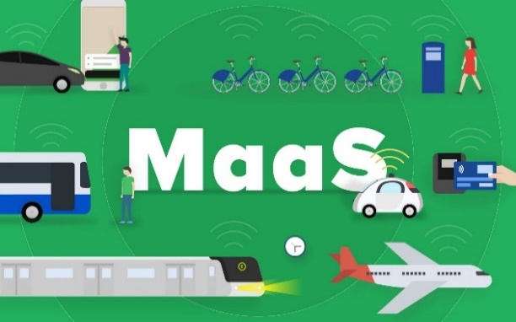
CHANGING PARADIGM
REFLECTIONS ON PUBLIC TRANSPORT

Slide 12
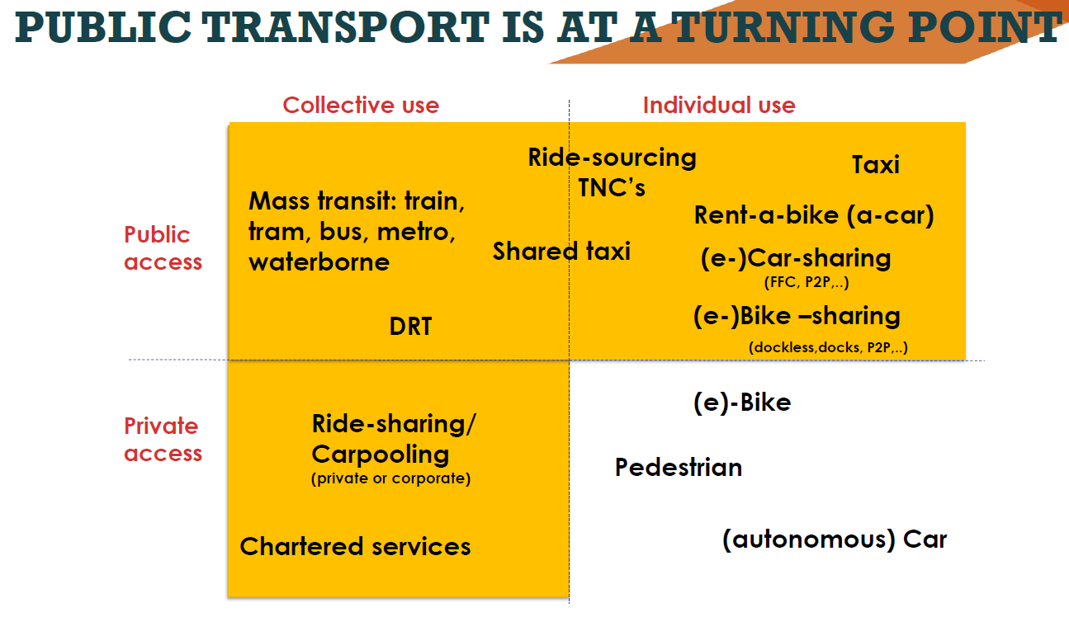
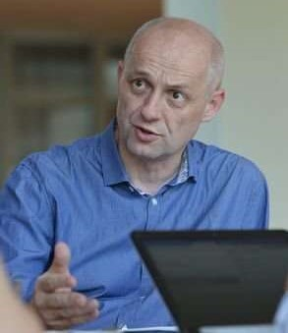
REFLECTIONS ON PUBLIC TRANSPORT
“Urban automation is driving change. Taxis will be autonomous in 10 years and this will impact on public transport services.” Sandor Nagy, Szeged Vice Mayor
Notes:
DRT = Demand-responsive transport
TNC = Transport network company ride-sourcing (Lyft, Uber)
P2P = peer to peer (TaxiStop.be)
FFC = free- floating carsharing (e.g. Car2Go, GreenWheels)
Corp. car-pooling (Taxistop.be)
Chartered Services: (e.g. Sonderborg region’s Lansbybus/Landsbybil/CountryCar)

Slide 13


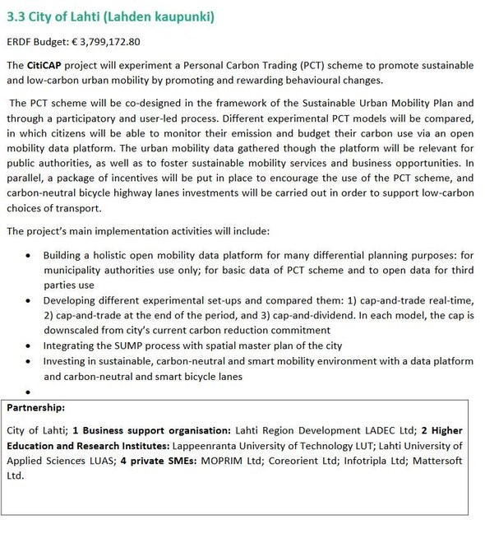
ON
LOW-CARB PLANNING…
CITICAP is one of five new ERDF Urban Mobility Innovative Actions undertaken by the city of Lahti (Finland)
The project develops a Personal Carbon Trading (PCT) scheme (cap and trade real-time/periodically or cap and dividend) to promote low-carbon urban mobility by promoting and rewarding behavioural change
The scheme will be co-designed in the framework of the Sustainable Urban Mobility Plan and through a participatory and user-led process.
Citizens will be able to monitor their emission and budget their carbon use via an open mobility data platform
Public authorities will use the data to foster sustainable mobility services and business opportunities
Incentives will encourage scheme use, while carbon-neutral bicycle highway
lane investments will support low-carbon choices of transport
www.smartlahti.fi/citicap

Slide 14
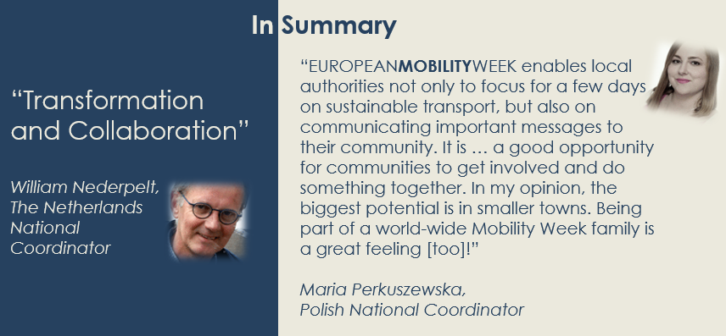
Why GET INVOLVED?

Slide 15
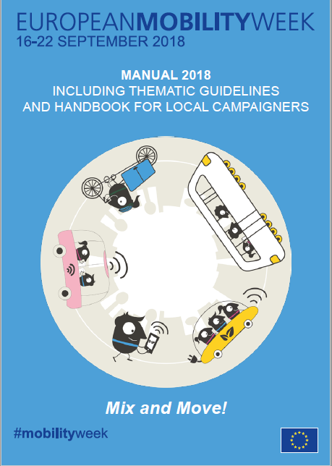
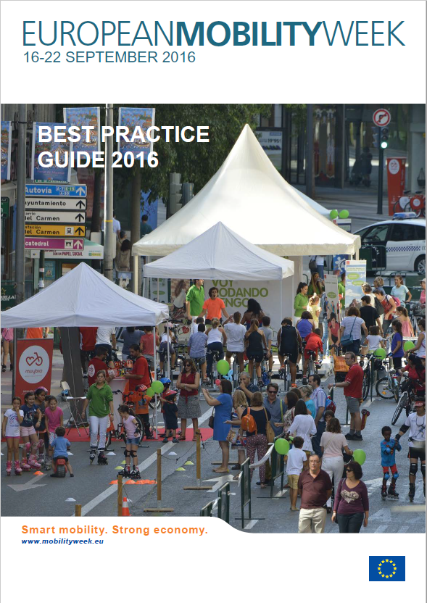

FURTHER READING
CAMPAIGN HANDBOOK & GUIDELINES
BEST PRACTICE GUIDE 2016
Online at: mobilityweek.eu/campaign-resources/

Slide 16
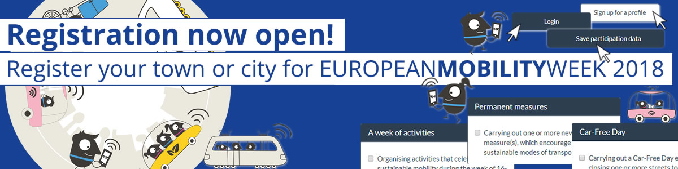
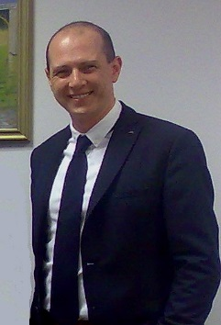


Jerome Simpson
Contact Details
EMW Secretariat c/o Regional Environmental Center
Ady Endre ut 9-11
Jsimpson@rec.org @jeromesimpson2
www.rec.org
Thank you for your attention!

