Slide 1
LOW-CARB Partner Meeting and Transnational Workshop
Brno 23 - 25 May 2018
SUMPs for functional regions in Slovenia
Experiences, challenges and future
Luka Mladenovič
Urban Planning Institute of the Republic of Slovenia

Slide 2


Experiences
Involved in SUMPs since 2003
Managed development of several SUMPs in Slovenia
National guidance on SUMP in 2012
Managing national SUMP platform
Trainers for SIovenia, Croatia & other countries in region

Slide 3
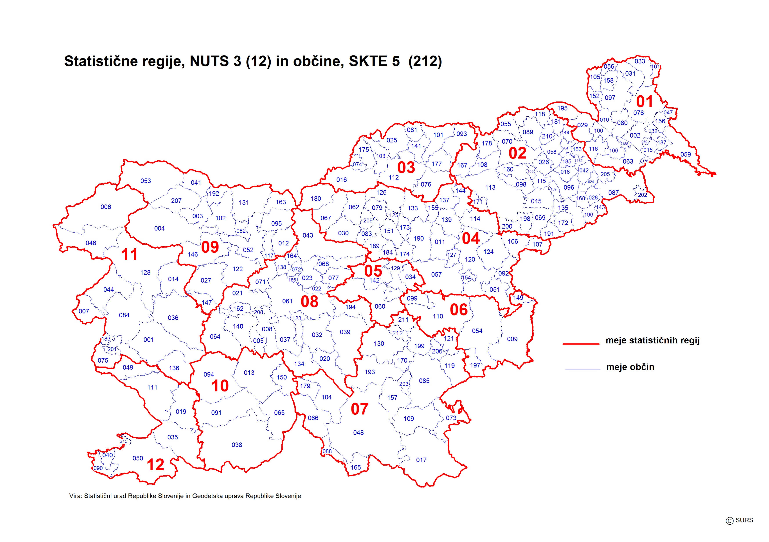
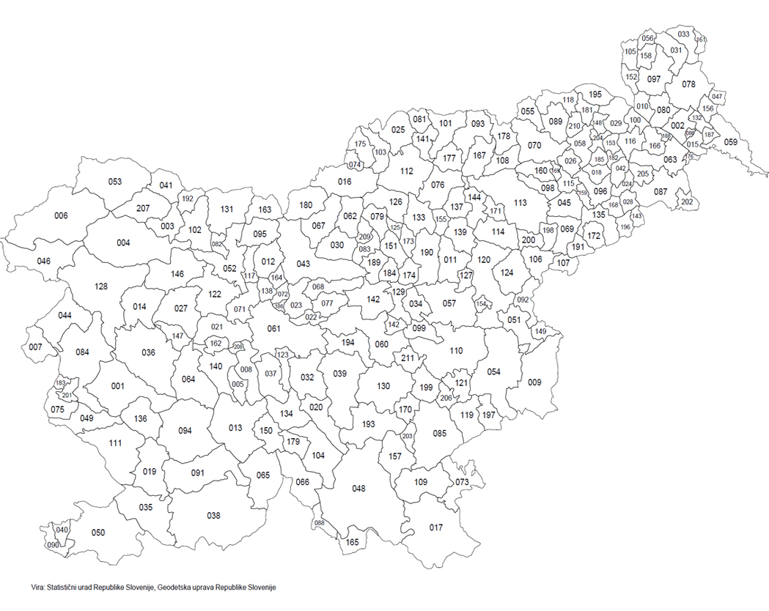
Slovenian planning and administrative preconditions
More than 200 municipalities, some really small
11 „city municipalities“
No regional administrative level
No tradition of strategic transport planning

Slide 4
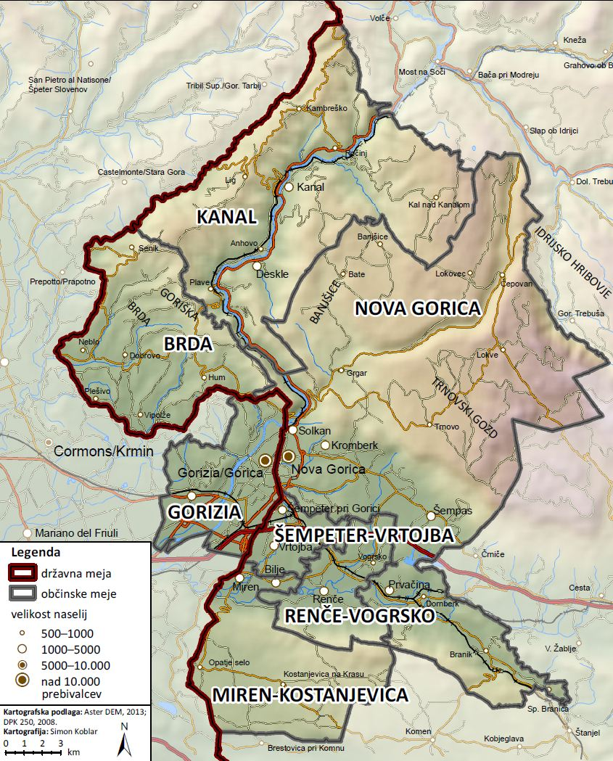

PUMAS
(Alpine Space 2012-15)

Slide 5
Preconditions
SUMP Nova Gorica from 2007 and Transport plan of Gorizia from 2006 both expired.
Small municipalities without transport strategies and with lack of capacities to prepare one.
Missing experience in key elements of SUMP planning:
Integration between sectors
Decision making transparency
Stakeholder and citizen engagement
Monitoring and evaluation

Slide 6
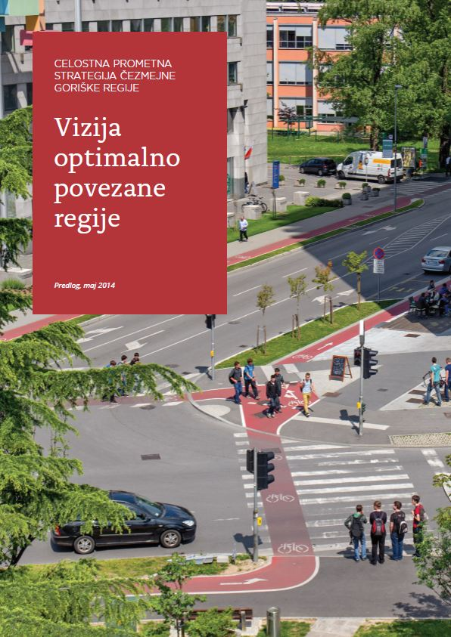
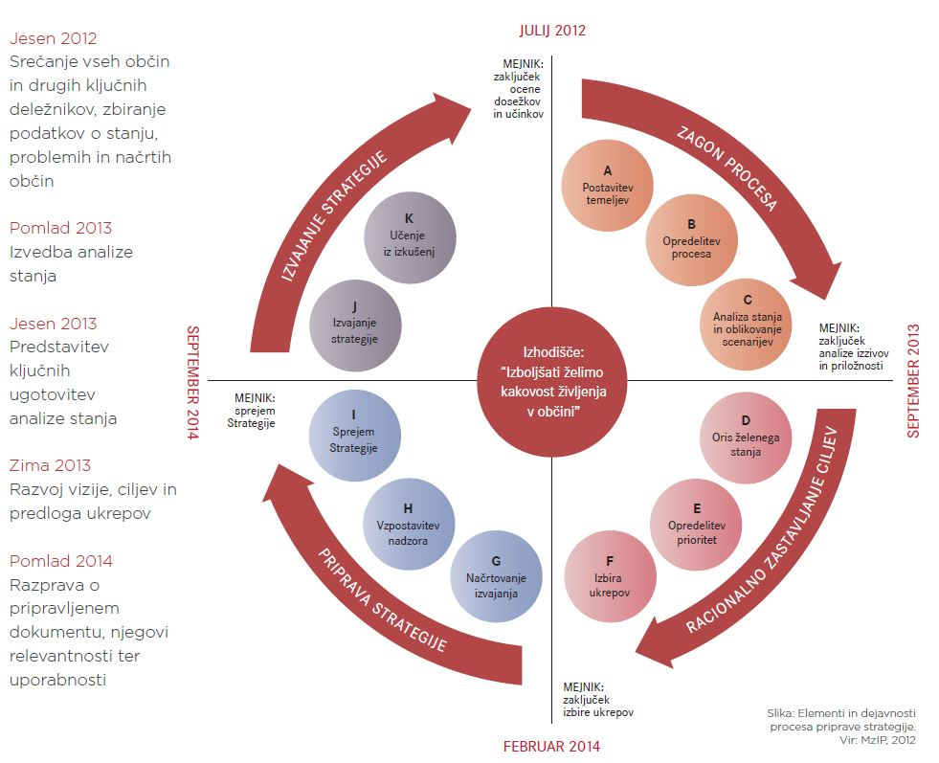
Development process

Slide 7
Main challengess
Two types of municipalities (urban – rural)
Cross-border: two legal systems, two languages
Type of document – regional strategy – hard to communicate
Limited interest and public involvement
Large number of stakeholders - hard to manage
PT main topic in this scale, though limited responsibilites by municipalities
Small scale solutions such as safe routes to school, traffic calming, parking management, connectivity of walking and cycling network could not be approached
Conclusion: Need for locals SUMPs before approaching the regional topics

Slide 8
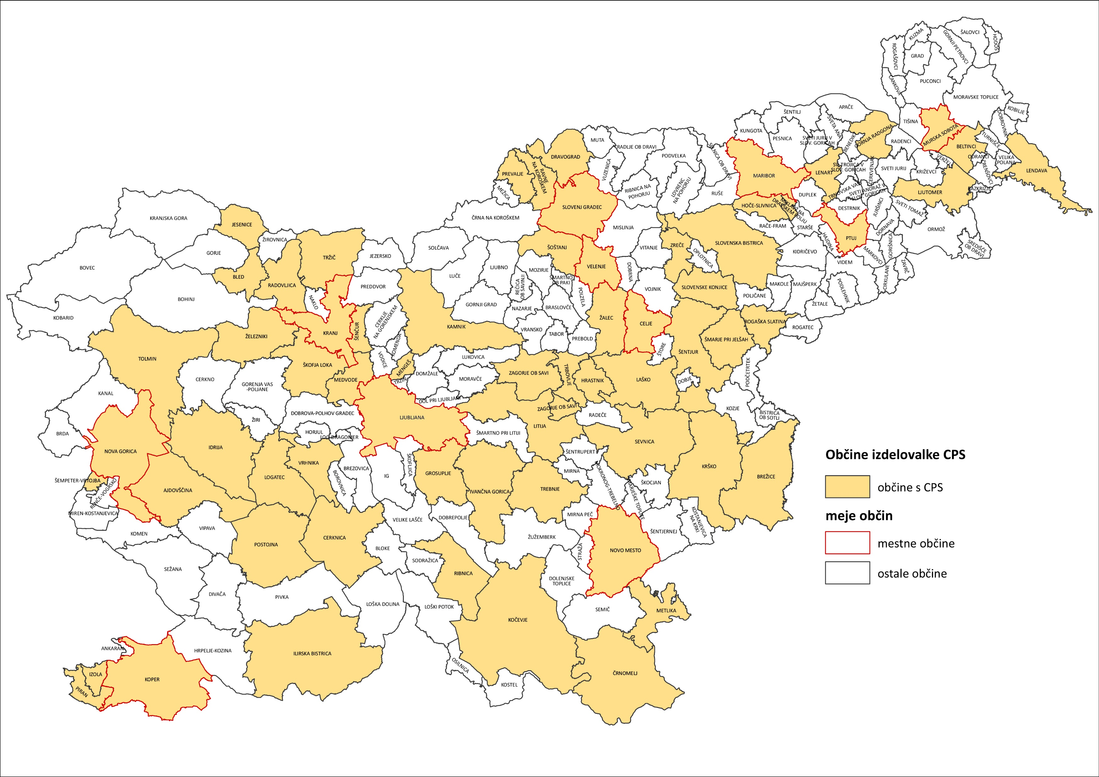
Current state in Slovenia
Local SUMPs not obligatory but precondition to aplly for tenders
More than 70 municipalities with SUMPs since 2017
A lot done in capacity building
Many planned and implemented measures on local level
Need for regional approach resurfaced
Some functional regions already work together within EMW initiative

Slide 9
Future plans
Network of expert groups on regional level to work on integration of local SUMPs and addressing the regional challengess
Renewal of SUMP guidlines when EU Guidlines 2.0 are awailable
Thematic guidelines to support the basic SUMP guidelines
  Already developed: walking, cycling infrastructure, P+R
  In development: mobility plans, integration of spatial and transport planning
  Planned: parking management, school mobility, alternative PT, etc.
Testing of approach within EU projects

Slide 10

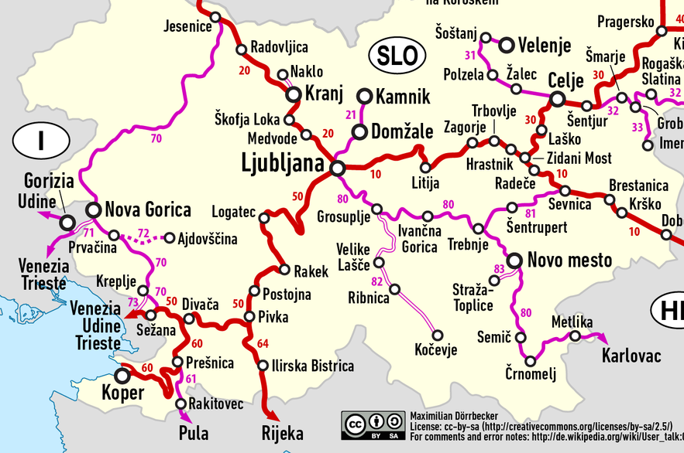

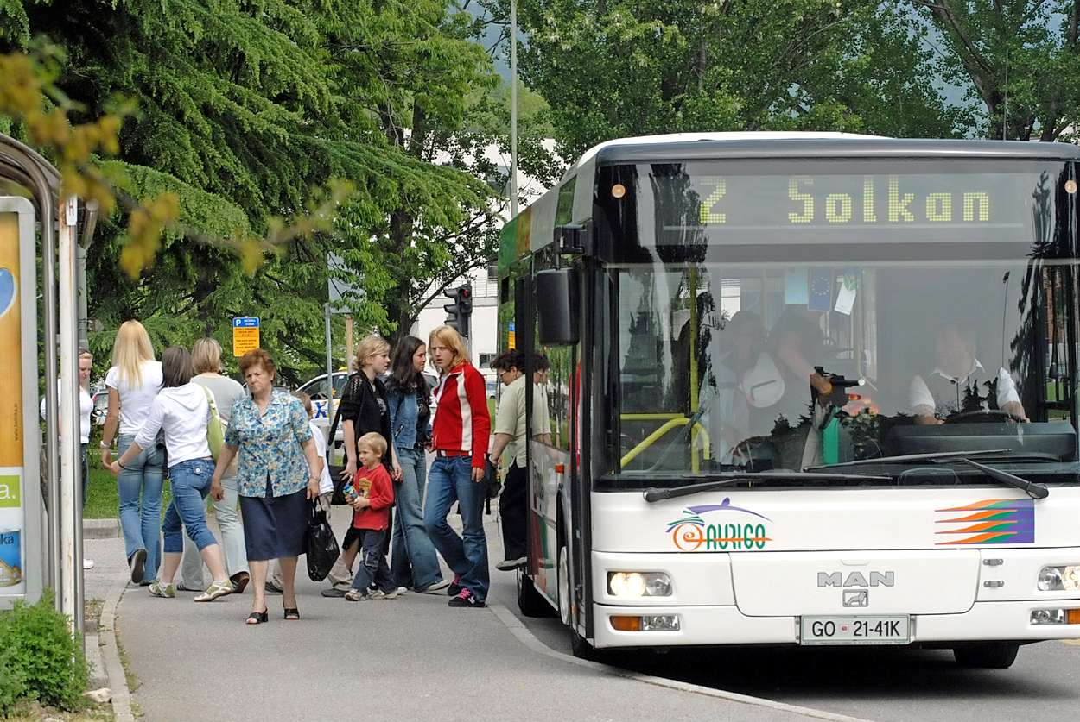
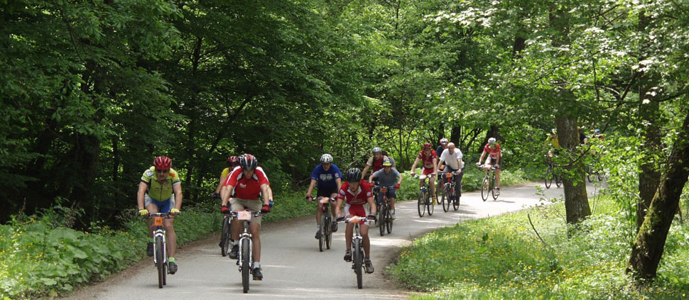
Future plans
Testing of approach within EU projects CROSSMOBY

Slide 11
Thank you for your attention!
Luka Mladenovič
Urban Planning Institute of the Republic of Slovenia
luka.mladenovic@uirs.si
www.uirs.si
www.trajnostnamobilnost.si

