Slide 1
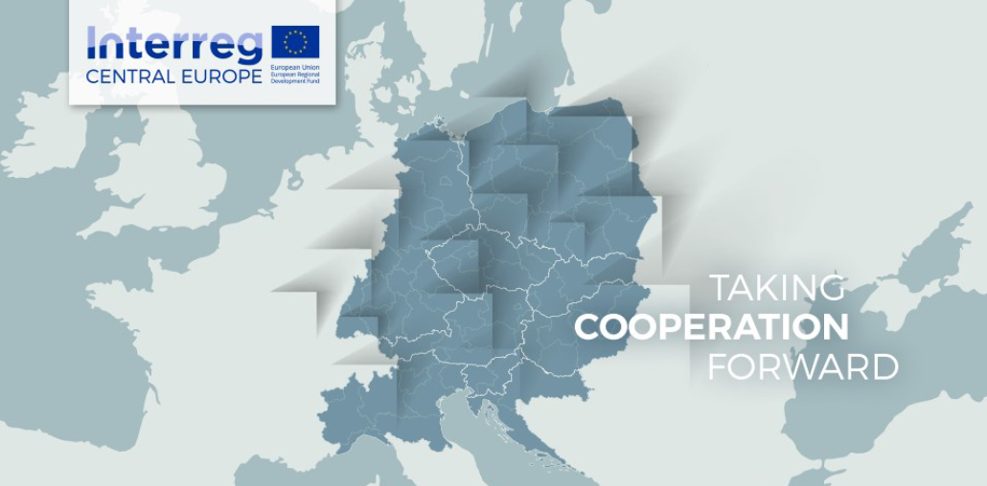
LOW-CARB Workshop
Brno | 25 May 2018
Transnational Workshop: Regional Sustainable Urban Mobility Planning for Functional Urban Areas: Improving Capacities to Lower CO2 Emissions

Slide 2
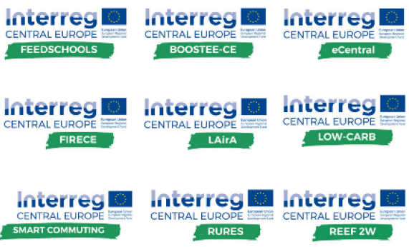
PROGRAMME INFORMATION
LOW CARBON CITIES
AND REGIONS
Who funds us
Our project is funded by the Interreg CENTRAL EUROPE Programme that encourages cooperation on shared challenges in CE.
LOW-CARB is in the 2nd call (2017) under the priority 2/ specific objective 2.3:
Priority 2: Cooperating on low-carbon strategies in CENTRAL EUROPE
Priority specific objective 2.3: To improve capacities for mobility planning in functional urban areas to lower CO2 emissions.
TAKING COOPERATION FORWARD

Slide 3
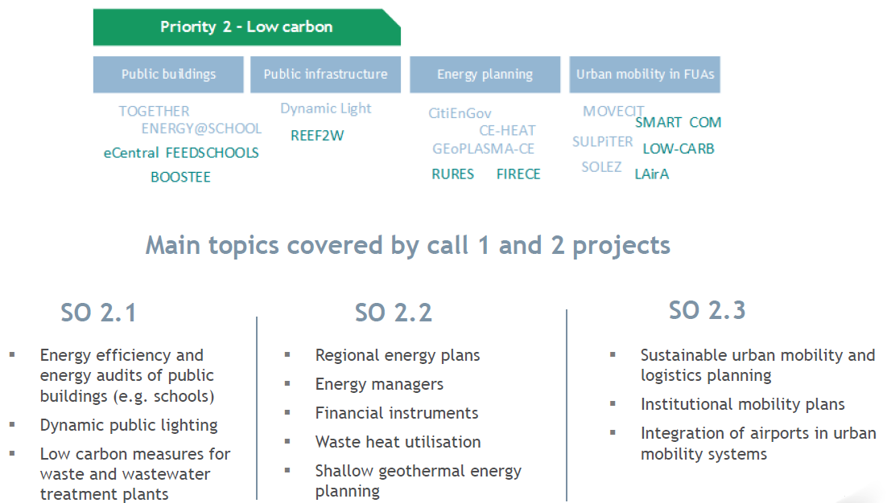
LOW CARBON - THEMATIC COVERAGE
TAKING COOPERATION FORWARD

Slide 4
EUROPEAN context
EU White Paper 2011 goals:
To halve the use of conventionally fuelled vehicles in cities by 2030
To cut carbon emissions in transport by 60% by 2050
EU Regulation 1303/2013 outlining common provisions for ERDF, ESF, Cohesion Fund a.o.:
public authorities are recommended to develop integrated urban mobility plan according to the SUMP methodology as an „ex-ante condition“
EU Cohesion Policy 2014-2020 (ERDF, ESF, Cohesion Fund)
Thematic Objective 4: Supporting the shift towards a low-carbon economy in all sectors
TAKING COOPERATION FORWARD
Notes:
LOW-CARB contributes to reaching the ambitious goals of the 2011 Trabsport White Paper to halve the use of conventionally fuelled vehicles in cities by 2030 and to cut carbon emissions in transport by 60% by 2050. The SUMP approach is promoted in EU’s Urban Mobility Package (2013), along with urban access regulations or the deployment of Intelligent Transport System (ITS) solutions in urban areas. Each of these topics is not only addressed within LOW-CARB, but will also be extended by a regional perspective on FUAs. Furthermore, it becomes increasingly mandatory that authorities seeking co-funding from the EU for sustainable transport projects have to develop a sound, feasible and cost effective integrated urban mobility plan according to the SUMP methodology as an “ex-ante-conditionally” (EU Regulation (1303/2013) outlining common provisions for EU Structural & Investment Funds for the 2014-2020 programming period). LOW-CARB will support authorities in CE program area to fulfill this condition for follow-up transport investments through capacity building for integrated low-carbon mobility planning. This will also support part of EU Cohesion Policy, in particular under Thematic Objective 4—“Supporting the shift towards a low-carbon economy in all sectors” and related investments to develop sustainable urban public transport systems across the EU in the period for 2014-2020.

Slide 5
EUROPEAN context - SUMP 2.0 process
CiViTAS
Horizon 2020
Smart Cities
Interreg CE
Interreg BSR
Interreg MED
Covenant of Mayors
Thematic groups
SUMPs-Up
SEAPs
PROSPERITY
CH4LLENGE
LOW-CARB
GO SUMP
Triangulum
TROLLEY
cities.multimodal
TAKING COOPERATION FORWARD
Notes:
LOW-CARB creates synergies with existing initiatives and projects on SUMP and low-carbon mobility services and technologies. Koprivnica and Brno are part of the CIVITAS initiative, which introduces innovations and measures for integrated sustainable mobility processes. They are members of the following CIVITAS thematic groups: Integrated Planning, Clean Fuels and Vehicles, Collective Passenger Transport. The consortium will use these groups to enhance development of LOW-CARB solutions and will conduct joint training activities.
LOW-CARB PPs have been involved or are involved in ongoing SUMP projects and initiatives: CH4LLENGE, Poly-SUMP and ENDURANCE, which have developed stakeholder networks, tools and methodologies to strengthen the quality of SUMP processes.
LOW-CARB also aims at cooperating through complementary actions with the newly funded Horizon2020 projects SUMPs-Up and PROSPERITY, aiming at accelerating the take-up of the SUMP concept. LOW-CARB PPs will share their expertise and add regional perspectives for the SUMP process in FUAs to these projects.
PP Leipzig is partner in the Smart Cities and Communities (SCC) Triangulum project. SCC links several sectors integrating energy efficiency, mobility solutions and intelligent use of ICT into planning processes which will lead to integrated land-use and mobility concepts to be used in LOW-CARB.
PP Leipzig will also create synergies with the recently approved CE project MobiPlan or the thematically relevant projects from other areas: "cities.multimodal" (BSR Programme) and "GO SUMP" (MED Programme).
LOW-CARB will build on the work from previous European projects, like the CE TROLLEY and Horizon 2020 ELIPTIC projects (both on electrification of PT) and the recently finalised project NODES (on urban transport interchange design), and will create synergies with the Covenant of Mayors’ SEAP and open data EU initiatives like PublicData.eu.

